Slide 1
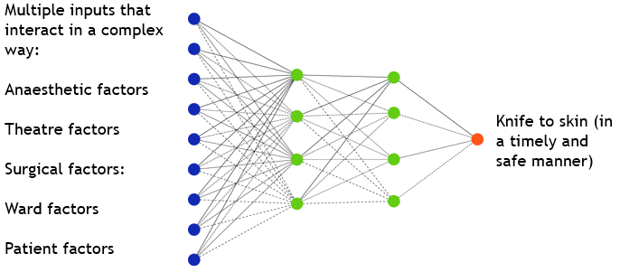
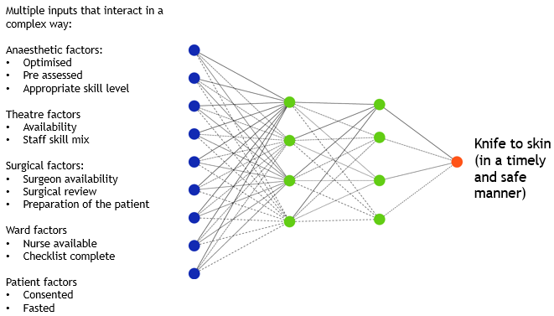
CEPOD: Collaborative Effort for Patient Outcome Development
Bandara KMKC, Tulloch H, Gebalanage I, Wijesinghe I, Baxter-Evans N, De-Silva A
I
Introduction
Dedicated theatre lists for emergencies during normal working hours were introduced into UK hospitals in the early 1990s as a result of recommendations of the National Confidential Enquiries into Perioperative Deaths (NCEPOD). CEPOD theatres are now ubiquitous however the efficiency of such a list remains a challenge. Multiple inter-dependant factors interact in order for a patient to be operated on in a timely and safe way (see figure 3). This project attempted to identify inefficiencies in the process of getting an emergency patient to theatre and introduced improvements to the system to optimise use of theatre time.
M
Method
Over a one-month period, the team collected data on 95 patients that were booked and operated on the CEPOD theatre. Data collection was done between 0800 and 1800 every day, including weekends. The information collected included time of booking, time of surgery, urgency of case, and length and reason for delay if applicable.
Figure 3. CEPOD as complex system
C
Conclusion
We presented the data at clinical governance meetings of all surgical subspecialties and collated feedback on improving efficiency and engagement. summary of action plan
0800 CEPOD ‘huddle’ where surgical specialties come to discuss their pending patients and to ascribe an order.
Transparent electronic booking system
Golden patient prepared the previous day to be first on the list.
A checklist to ensure patient is adequately prepared
Appointing leads from surgical and anaesthetic team to drive progress forwards
Taking collaborative decisions for changes to have a better engagement
A re-audit is in progress, and we hope to present the results at the conference.
R
Results
Overall, the majority of patients (61%) were not being operated within recommended timelines. Patients that were booked as ‘urgent’ (i.e. Requiring surgery in 2-6 hours) were more than half the time not meeting that target. We also identified common themes on the factors leading to delays (as shown in figure 3), and a snowballing effect where one delay leads to another.
 | Immediate | Urgent | Expedited
No delays | 3 (37.5%) | 16 (34.8%) | 11 (29.7%)
Delays identified | 5 (62.5%) | 30 (65.2%) | 26 (70.3%)
Figure 1. Delays seen by urgency of operation
Figure 2. Delays in bringing patient to theatre (for all reasons) against urgency of operation.
Acknowledgments: Many thanks to our colleagues who helped with data collection
References: Buck N, Devlin HB, Lunn JN. The report of a confidential enquiry into perioperative deaths. London: Nuffield Provincial Hospitals Trust/King's Fund Publishing Office 1987.

